Slide 1
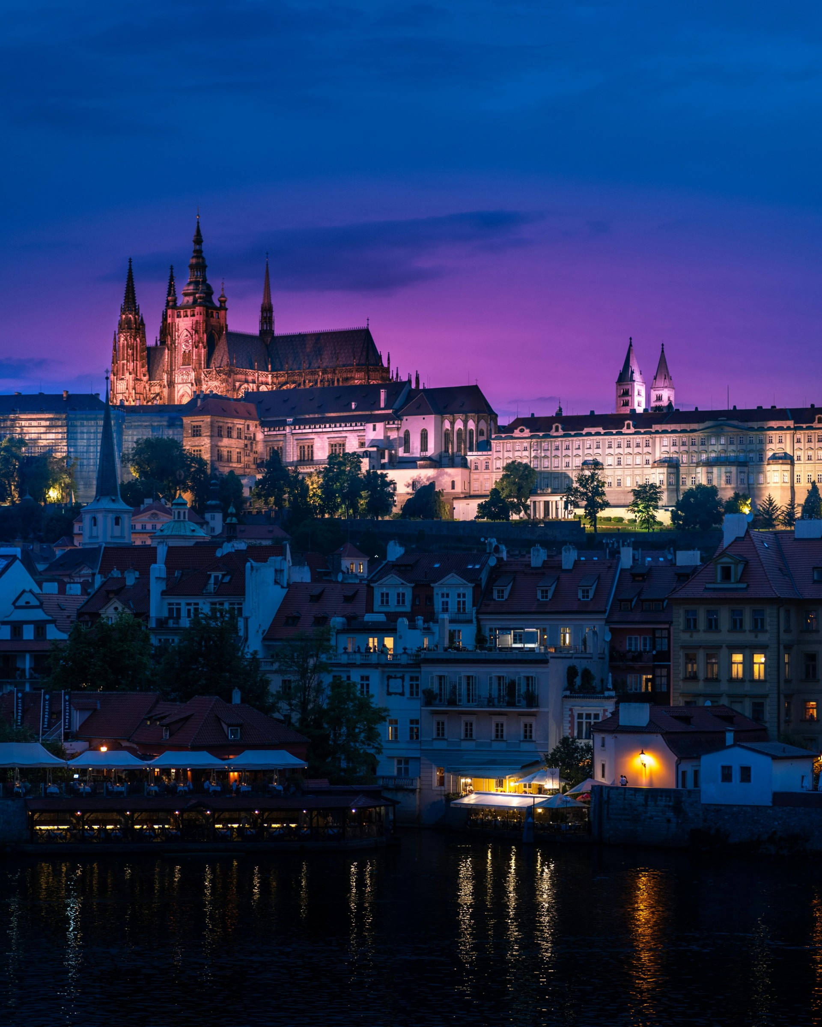



SAVE THE DATE
12-14 September 2025 Prague, Czech Republic
www.dfsg.org

